Slide 1
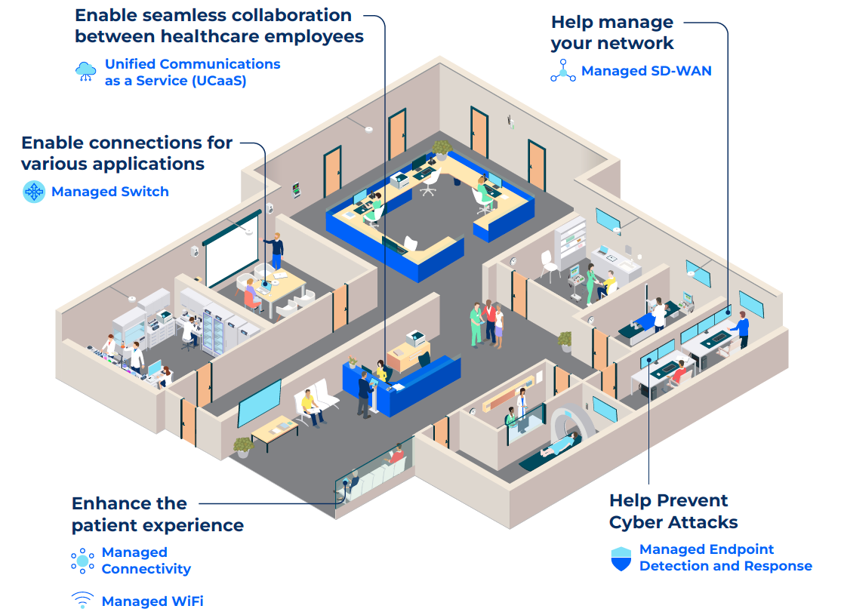
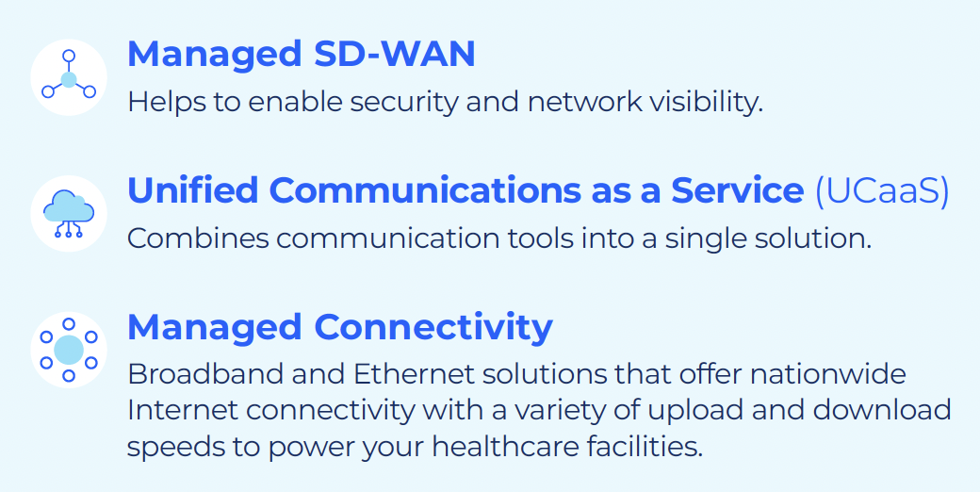




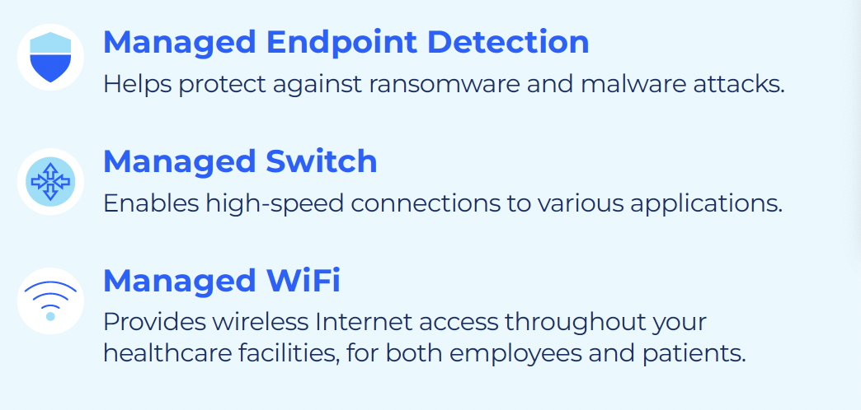


How Do You Imagine…the Future of Healthcare?
SOLUTIONS KEY

Slide 2




Giving Healthcare Facilities What They Need
A partner for agility, growth and innovation
Scalable access to handle patient data and HRE processing loads
Connected care and communication for greater patient experience and engagement
Security to help protect against breaches and hacks
Network enhancements to
enable digital healthcare and real-time, data-driven decision making
Reliability to support a frictionless healthcare ecosystem
IT innovation — and managed
services — to transform to an increasingly digital business model

Slide 3







Network demands
Is Your Healthcare Facility Keeping Up With The Evolving
Technology And Security Landscape?
Our Secure Networking Solutions
Cloud / SaaS applications
Optimized network traffic
Performance | Security | Bandwidth
Telemedicine
Video, IoT, digitalization
(Edge data consumption)
Application prioritization
Visibility and control
Business Demands
Agility | Risk
Automation & Orchestration
Security
3

Slide 4

Low Earth Orbiting (LEO) Satellite
Innovative satellite internet solutions for your enterprise
Leveraging an advanced satellite network, Comcast Business can provide reliable, high-speed, and flexible internet services, ideal for rural and remote areas, network redundancy, and expands our coverage to hard-to-reach areas.
Speed
20/10 Mbps Speed
Best effort with anticipated 99% uptime
Connectivity
Robust, seamless connectivity, even in rural/ remote areas
Resiliency
Help improve business continuity with network redundancy option
Delivering robust connectivity solutions by integrating satellite capabilities all from one managed provider

Slide 5
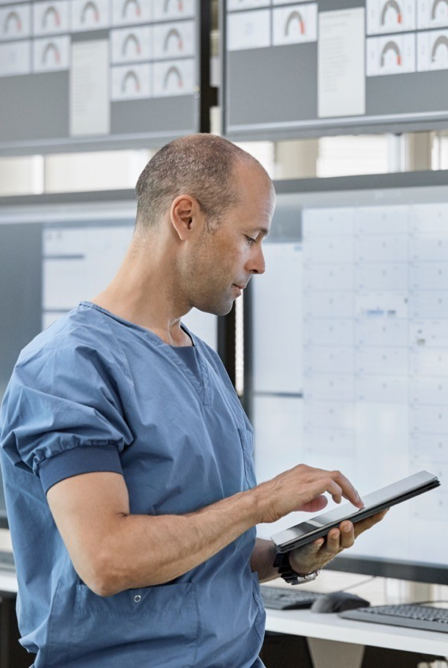
Ethernet for Healthcare Providers
Delivers performance on proven technology
Run your healthcare operations and ensure that your staff has the capacity to access data-intensive applications. Care staff and patients have the bandwidth to stream videos and surf the web from multiple devices.
Scalable capacity from 2Mbps up to 100Gbps that can be easily adjusted based on demand
Connect geographically dispersed facilities
Cost-effective alternative to other technologies
High performance network well-suited to support staff/visitor Wi-Fi connections
Five unique solutions: Ethernet Dedicated Internet, Private Line, Ethernet Network Services, Ethernet Virtual Private Line, Direct2Cloud

Slide 6
Power Your Business With A Next Generation Network
When you choose Comcast Business, you choose a next generation network that’s always improving – getting faster, more reliable and more intelligent to help keep you ready.
Backed by our advanced network, you get:
Reliability
Speed
Robust Solutions
Service
A network that you can count on.
Faster than ever connectivity solutions for every business.
Full suite of solutions that deliver.
Excellent customer support.

Slide 7
A Diverse Network
High Bandwidth – 2 Mbps scaling up to 100 Gbps
Nationwide coverage
Latency and jitter SLAs with Ethernet Transport Services (EPL, EVPL, ENS)
Availability SLAs with Dedicated Internet (DI) and Ethernet Transport Services (EPL, EVPL, ENS)
Physically diverse network from telcos
Self-serve customer portal
Network monitoring and management
24x7x365 from redundant NOCs
Over 1.8 million Ethernet-enabled buildings
Capacity that scales up to 100 Gbps
185k fiber
route miles
700+ connected
data centers
One of the largest Voice over IP provider in the nation
Notes:
We are committed to continuous improvement by investing billions in our network.
We offer a diverse network with high bandwidth, nationwide coverage, latency and jitter SLAs, availability SLA, a physically diverse network, a self-serve customer portal, and network monitoring and management.
We have over 1.8 million ethernet enabled buildings and capacity that scales up to 100 GB.

Slide 8
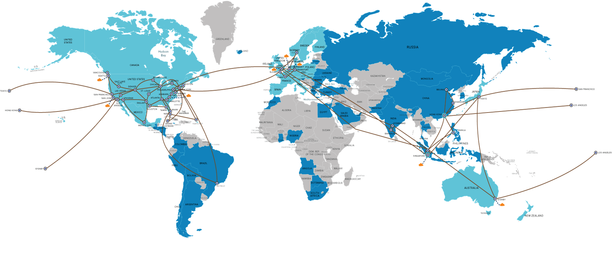
Global Coverage
MAP KEY
Countries with PSTN replacement
Countries with Comcast Clients
POP
Direct Cloud Connects
Notes:
Not only do we have a diverse network, but we offer coverage all over the globe to meet you where you are.
Our global secure networking capabilities plus over 50 points of presence in cities around the world, in 115 countries across 5 continents, allow us to serve your business regardless of where you’re located.

Slide 9
Appendix

Slide 10
What We Stand For & Deliver
Global solutions delivered at scale to businesses of all sizes.
Connectivity
Global network that’s always improving and getting faster, more reliable and more intelligent
Secure Networking
Secure SD-WAN covering full spectrum of business needs and robust cybersecurity protection
Communication & Collaboration
Expanded managed voice, UCaaS, and collaboration capabilities
IoT Applications
Emerging IoT leadership for critical business applications, vertical use cases and sustainability
Experience
Managed solutions for businesses of all sizes + centralized digital experience and AIOps for unified visibility and efficient solution management
Deliver better outcomes & experience to end-users
Enable smarter, more efficient operations
Embrace innovation, strategic planning to help you stay ahead of the curve

Slide 11







Comcast Business delivers technology to power healthcare providers
Ethernet
High speed fiber network assuring private data connectivity across locations, data centers or cloud providers
Speed
Control
Security
Visibility
IT Deployment Services
Nationwide end-to-end network support
Video
Xfinity TV & Entertainment for break rooms and conference rooms
Internet
Up to 1 Gig Internet and WAN Connectivity
Voice
Advanced voice solutions
Healthcare
Managed Services
Connectivity, security, business continuity, WiFi, routers and voice
IoT
Network as a Solution connecting IoT solutions
Global Secure Networking
SD-WAN, Unified Security, Unified Secure Access
Cybersecurity Solutions
DDoS Mitigation and Managed Security
WiFi
Reliable WiFi network and IT infrastructure
to support connectivity

Slide 12
Comcast Business Has Solutions for Your Connectivity Needs
Ethernet Private Line
point-to-point connectivity between two sites
Ethernet Network Services
multipoint-to-multipoint connectivity
Ethernet Virtual Private Line
point-to-multipoint connections
Direct2Cloud
private connection from designated location to cloud service provider
DIRECT TO INTERNET
TO YOUR NETWORK
BI
EDI
EPL
D2C
EVPL
Wavelength Services
dedicated point-to-point optical
Teleworker
oDIA
Waves
Dedicated Internet
dedicated connectivity between LAN and Internet
ENS
Off-Net Dedicated Internet Access
dedicated Internet access provided by off-net vendor with their assets
1.25 Gig, Nationwide
1 G, 10G, Nationwide, Symmetric Speeds Available, SLAs
Business Internet
fast, reliable Internet service
Teleworker
fast, reliable business-grade Internet at home

Slide 13
Customer Testimonials
Enhance Crisis Hotline Operations
Bridge the Digital Gap for Underserved Patients
Support Patient Care
“
“
“
Functioning technology is the difference between life and death for the people we serve. Comcast Business provides excellent service that enables our staff to not only manage calls and support clients, but also seamlessly interact with one another and handle administrative tasks without fear of an unreliable connection.
– Lara Holt, Office Manager, Clearfield-Jefferson Drug and Alcohol Commission
I was proud of how we were able to quickly pivot and provide telehealth services to our community. We couldn’t have done that without the infrastructure that Comcast Business provided. With our broadband Internet, we can ensure our patients have adequate access to stay connected with their primary care providers.
– Gerardo Loera, Director of Development and Communications, Indian Health Center of Santa Clara Valley
The best care requires a great communications infrastructure, and we’re grateful to partner with Comcast Business as they provide our staff with reliable, scalable, seamless communications services so we can deliver an exceptional patient experience across all our departments and centers.
– Dr. Andrey Ostrovsky, CEO, Concerted Care Group
Notes:
Share our Healthcare Industry Voices information sheet with customers for more information.
https://mysource.comcast.com/documents/sppreview/da909975-f426-478e-a1de-2fe1b261e344

Slide 14

Digital Agility & Transformation
“
The best care requires a great communications infrastructure, and we’re grateful to partner with Comcast Business as they provide our staff with reliable, scalable, seamless communications services so we can deliver an exceptional patient experience across all
our departments and centers.
– Dr. Andrey Ostrovsky, CEO of Concerted Care Group

Slide 15
Accelerating Digital Transformation
Ability to respond to disruptions with resiliency
Existing business models may lack agility
Accelerate adoption of digital-first patient care
- Mobile health, telehealth, home monitoring, etc.
IT strategies not aligned with business strategies
Engage patients across in-person and remote channels
Existing technology may not support “connected” experiences
What healthcare providers need:
What’s holding them back:
Care team collaboration and data/records exchange
Bandwidth constraints limit processing loads
Security solutions for data and network
No depth in cyber defense strategy
Optimize costs
Disparate networks & overburdened IT

Slide 16
The Value of Digital Transformation
Digital transformation technologies
Value delivered
Innovation in the HEALTHCARE industry
Integrated virtual care and connected care platforms
Imaging, genomics, personalized medicine
Core EHR technology and consumer-generated health data repositories
Big data analytics and decision support
Cybersecurity
Population health management platforms
Interoperability and health system navigation
Patient access management
Build virtual capabilities for digital patient encounters.
Enable digital healthcare for real-time data-driven decision making and application performance.
Drive automation to help improve staff productivity by shifting care away from in-hospital setting.
Create superior patient experiences through network enhancements that engage patients as healthcare consumers.
Help organizations become more agile, nimble and scalable to manage needs.

Slide 17
Enhancing the patient experience
A robust technology foundation is key to powering a next generation healthcare experience for patients
Leveraging advanced technologies and innovative solutions can lead to an improved patient experience, care and outcomes. The use of patient-centric tools, IoT and digital healthcare experiences can help drive a seamless patient solutions. Comcast Business can provide robust technology foundation for scalability.
Telemedicine options offer convenience for patients while enabling more accessible healthcare options.
Online Patient Monitoring ensures patients get the care they need, when they need it. In 3-5 years, medical professionals will be able to monitor patients via a wearable or medical device and will only have to interact with a doctor if a reading falls outside the parameter set up.
Virtual Surgical Options AR/VR can offer new, innovative solutions for patients.
Digital health apps keep patients informed and connected with their healthcare provider – including quick access to health records, messaging portals and appointment scheduling.
92%
of Americans
said having a good patient experience is extremely or very important to them¹
80%
of US counties
lack essential services to keep communities healthy²
1. Forbes https://www.forbes.com/sites/debgordon/2022/11/28/60-of-americans-have-hada-
recent-bad-healthcare-experience-new-survey-shows/?sh=18b1c7b62adf
2. Forrester Predictions Report 2024: Healthcare

Slide 18
Enhancing the employee experience
Power your people to better power patient outcomes
Enhancing the employee experience for healthcare professionals can also lead to improved patient care. When healthcare professionals have access to advanced tools, they can offer better solutions to their patients. This presents an opportunity for Comcast Business to power your healthcare system on our advanced network so you can have automated processes to help drive operational efficiency.
Medical staff burnout, caused by staffing shortages, can lead to lower quality care. Automating processes and creating operational efficiencies can empower employees.
Automation tools, such as robots, can help with logistical tasks and IoT can facilitate effective drug management and monitoring.
68%
of adults
worry that healthcare workforce shortages will impact patients¹
40%
of clinicians
say they do not have enough resources²
59%
of healthcare teams
are understaffed²
1. Bain & Company Survey, 2022
2. 2023 Patient Experience Survey, conducted by The Harris Poll on behalf of the American Academy of Physician Associates

Slide 19

Securing data and systems is more important than ever
Data security is crucial for healthcare providers. This presents an opportunity for Comcast Business as a provider of security solutions.
Despite 76% of healthcare professionals prioritizing security improvements 55% allocate 10% or less of their IT budget to cybersecurity, with 23% lacking a dedicated budget for it.¹
Outdated IT equipment is often the weak link in security, with 24% of incidents starting from such vulnerabilities. Some older technology poses a concern, with nearly half of the infrastructure in some organizations being outdated.²
1. Forrester’s Priorities Survey 2023
2. https://www.hipaajournal.com/healthcare-cybersecurity/

Slide 20
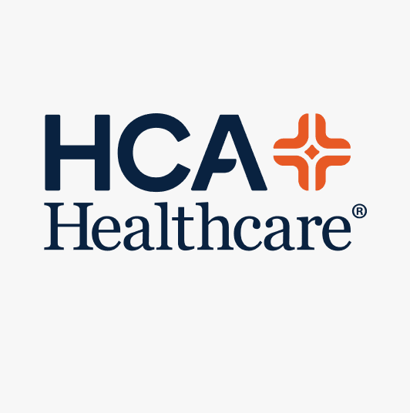

Predictions and Trends for Tech in Healthcare
Creating the tech teams of tomorrow
Senior technology leaders from HCA Healthcare and other enterprises discussed trends for digital innovation and talent management at a panel hosted by Comcast Business at THE PLAYERS Championship. Read about the key takeaways focused on creative problem-solving, organizational culture fit, and empowering women in tech.
READ ARTICLE
Manage your network and enhance network security with SDN
With software-defined networking (SDN), hospitals and providers can improve network performance, reduce the complexity of managing networks, and enhance security. Read about these and other benefits of SDN for healthcare.
READ ARTICLE

Slide 21

What Sets Us Apart
Driven by a partnership mindset & approach,
Comcast Business is continuously improving
Experienced
Service
Local
& Global
Automated
& Human
Innovative
& Practical
Notes:
Comcast Business is an innovative technology partner delivering best-in-class solutions to businesses of any size worldwide. We bring future-ready, global solutions together with a partnership mindset to drive growth for your business.
At Comcast Business, we’re driven by a partnership and mindset approach, allowing us to continuously improve through intimate customer engagement.
We provide personalized, expert service and managed experience for businesses of any size.
And we have a national and global reach, as well as a local presence in each community and market.
We offer automated solutions with human support and strategic partnership, giving you peace of mind from a stable company.
We have proven execution excellence and future-focused strategic partnership, with the early adoption of latest advancements without the uncertainty.

Slide 22

Power of Comcast Business
Global
Network
Cybersecurity
Choice &
Flexibility
Unified Visibility & Intelligence
Owned & Partner Ecosystem
Partnership
& Service
22
Notes:
Our owned and partner ecosystem showcases our culture of innovation and seamlessly integrates to meet your business needs.
And our comprehensive end-to-end solutions offer your business flexibility and choice, with an open, vendor agnostic approach and the ability to work within your existing tech stack, making working with us easier for you.
We are the largest, fastest, most reliable network, and this combined with our global network solutions allows us to serve businesses like yours around the world
Our comprehensive portfolio of cybersecurity solutions helps to avoid data breaches to keep your business secure. Our 24/7 security operations centers have the expertise and capability to detect and contain threats in advance.
With our unified visibility and intelligence, we have advanced analytics that help optimize your business performance, resiliency and support smart, efficient operations.
All of this, plus our unparalleled partnership and managed service experience, we’re committed to you throughout your entire customer journey.

Slide 23

Strength of Our Business
$123B
Total consolidated revenue
700+
Data centers
99%
Of footprint
with Gigabit broadband
$9B+
Of revenue
over the last
12 months
182K
Total
employees
2.6M
Business services customers
51M+
Total connectivity
& platforms customers
Largest
IP converged Network
*All figures are accurate as of 2024 unless otherwise noted.
Notes:
Comcast Business is a subsidiary of Comcast Corporation, one of the largest telecommunications companies and media conglomerates in the world, generating over 123B in total consolidated revenue.
Comcast Business has continued that tradition of financial stability and innovation, with over $9B in total revenue over the last 12 months, global network solutions and the largest, fastest, most reliable network in the United States.

Slide 24
Where we are
$9.7B
Run-Rate
  4.6%
  ’23 - ’24
  Growth Rate
  2.6M+
  Total Business Customers
  11K+
  Employees Dedicated to Business Services
$256M
2006
Today
Revenue
Notes:
Since inception in 2006, Comcast Business has been on a path of growth, with a current run rate of $9.7 billion.
We were up 4.6% year-over-year in 2024 and we are the only major provider that is growing.
We have over 2.6 million business customers, and behind our success are over 11,000 dedicated employees focused on delivering top-notch business services.
We are continuously improving through intimate customer engagement and have the best of both worlds: we have the energy and innovation of a start-up with the stability and backing of a large company with proven track record.

Slide 25



Trusted, future-ready partner
Comcast Business recognized in
2023 Gartner® Magic Quadrant™ for Managed Network Services
Comcast Business named a
Leader in the
2025 ISG Provider Lens for Managed SD-WAN Services,
SDN Transformation Services, and SASE
Comcast Business recognized as
#1 Ranked Provider for Managed SD-WAN by Vertical Systems
Group in 2024
Comcast Business named
a Leader in the
2024 Frost & Sullivan Managed Network
Services Radar Report

Slide 26


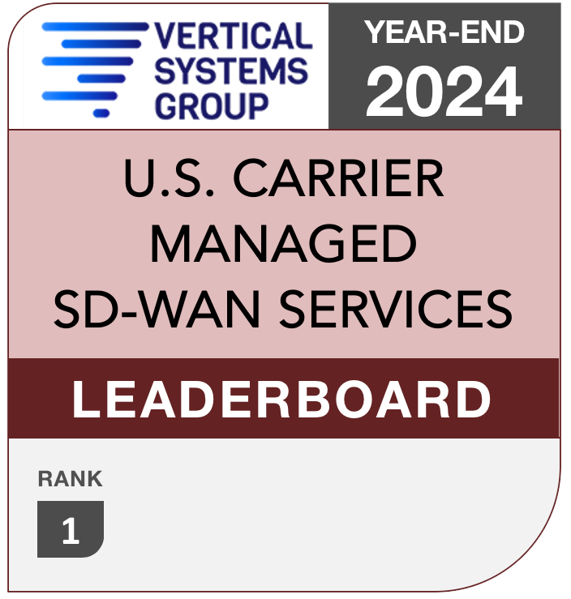



Comcast Business Recognized as
#1 Ranked Provider for Managed SD-WAN
1
#1
2
3
4
RANK
5
(Formally CenturyLink from 2018-2019)
6
7
8
2018
2019
2020
2021
2022
2023
2024
YEAR
Rankings based on number of customer installed sites

Slide 27
MachineQ Solutions
IoT Innovation for Healthcare
Enterprise-Grade IoT Connectivity & Services

Slide 28





Improve Decisions with Data
IoT solutions from Comcast company, MachineQ that make it easy for you to access real-time data and insights to make informed decisions
TEMPERATURE MONITORING
FACILITIES MANAGEMENT
ASSET
TRACKING
Enhance liability protocols by tracking the temperature of lab and pharmaceutical storage
Improve your hospital operations by monitoring energy usage, room occupancy, air-quality, temperature, door open-close, and pest control.
Enable workflow optimizations, real-time inventory management, and location services

